Slide 1

Statistical Physics
Crash Study on Yellow Hornet Expansion
GALLEAN Geoffroy
HUMBERT Théo
MUGICA-GONZALEZ Juan
PILLARD Marc

Slide 2
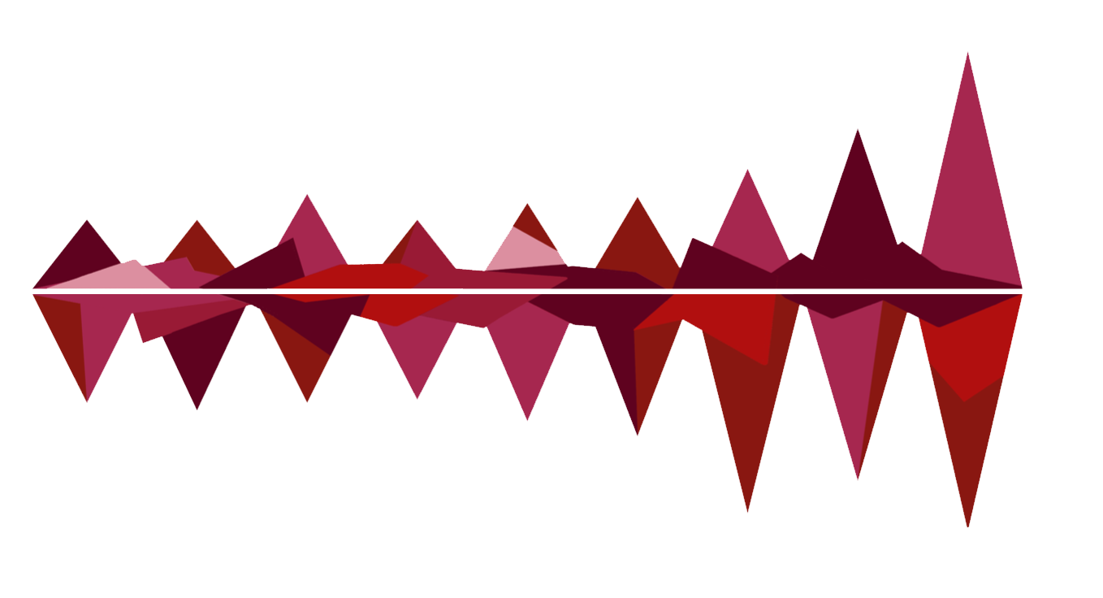



Statistics on French honey production
Alarming circumstances
NUMBER OF YELLOW HORNET SINCE 2004
(Nb of French Department Colonised/Year)
56
First Asian Yellow Hornet Hive detected in 2004
50
13
32
39
1
2
21
26
Bee Artificial Hives represent 2/3 of its preys
54
57
54
55
50
45
French first eradication plan demand in 2007
40
30
32
ESTIMATED EFFICIENCY OF BEE HIVES

Slide 3




CHOICES WE MADE
A New Way of Modelisation
Organizing the study by department
Avalanche scheme
The number of Hornet Queen may be multiplied by 5 per year
Facilitates exchanges between neighbors
Removes boundaries inside departments (average number)
Mean fly distance given by a Poisson Distribution

Slide 4
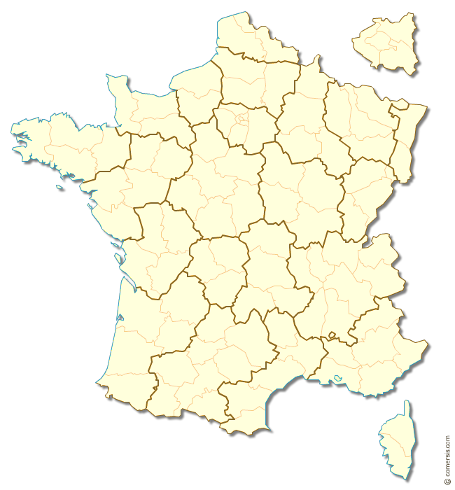



FURTHER EXPLANATION ON AVERAGE
How estimate the Hornet Concentration
IN FRANCE
Study by Department
Mean hive number by department
First Hornet detection
Overcrowded department given by concentration and mean area covered
Mean fly distance of 60 km

Slide 5

FURTHER EXPLANATION ON AVALANCHE
Birth
Queen Birth
A hive can give birth from one to five new queens. This number is given by a Poisson Distribution
Growing hives number
In a department, each hive covers a certain area. The sum of these areas implies a concentration of hives in the department.
Growing
Overcrowding
When the concentration reaches one, the number of hives can not change since Hornet are starting survival competition
Overcrowding
Prospect
At this point, we can consider that the excess of hives has reached others departments..
Prospect
Avalanche
Since then, the number of the overcrowded department change a little and the neighborhood is colonized.
Avalanche phenomena
Be aware
A hornet is more able to invade department with higher numbers of overcrowded neighbors
Be aware

Slide 6



FURTHER EXPLANATION ON AVALANCHE
Birth
Queen Birth
$Q_{i}= ℘\left(\frac{r}{1+ γC}\right)$ where r and 𝛄 must be chosen to fit with reality.
Growing hives number
In a department, each hive covers an area : $A_{i}=πr_{i}^{2} where r_{i}=℘\left(28\right).$
But a queen can travel 60 km.
Growing
Overcrowding
$$C=\frac{\sum{{πr_{i}}^{2}}}{{Area}_{Department}}>1$$
Overcrowding
Prospect
A hornet is more able to invade department with higher numbers of overcrowded neighbors
Prospect
Avalanche
Hornets which are able to travel the most are colonizing the neighborhood.
Avalanche phenomena
Be aware
Once the department is overcrowded, the population is stabilizing
Be aware

Slide 7
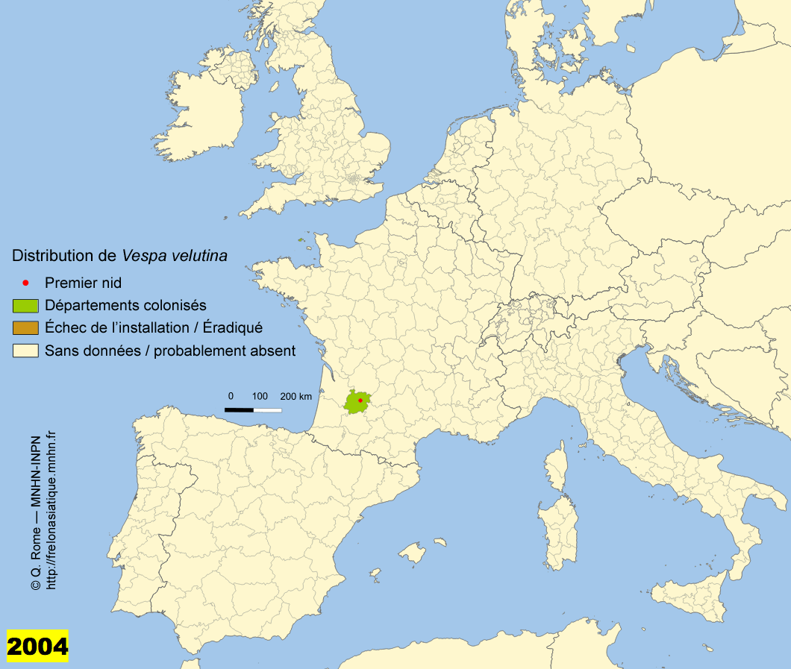
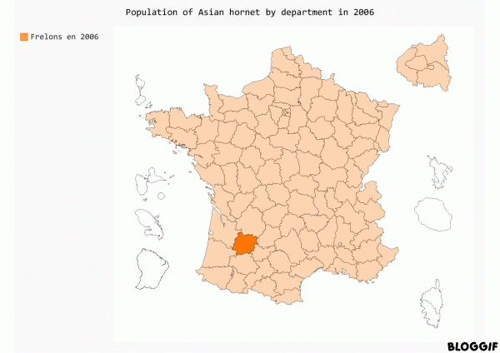
Results on Hornet Propagation

Slide 8
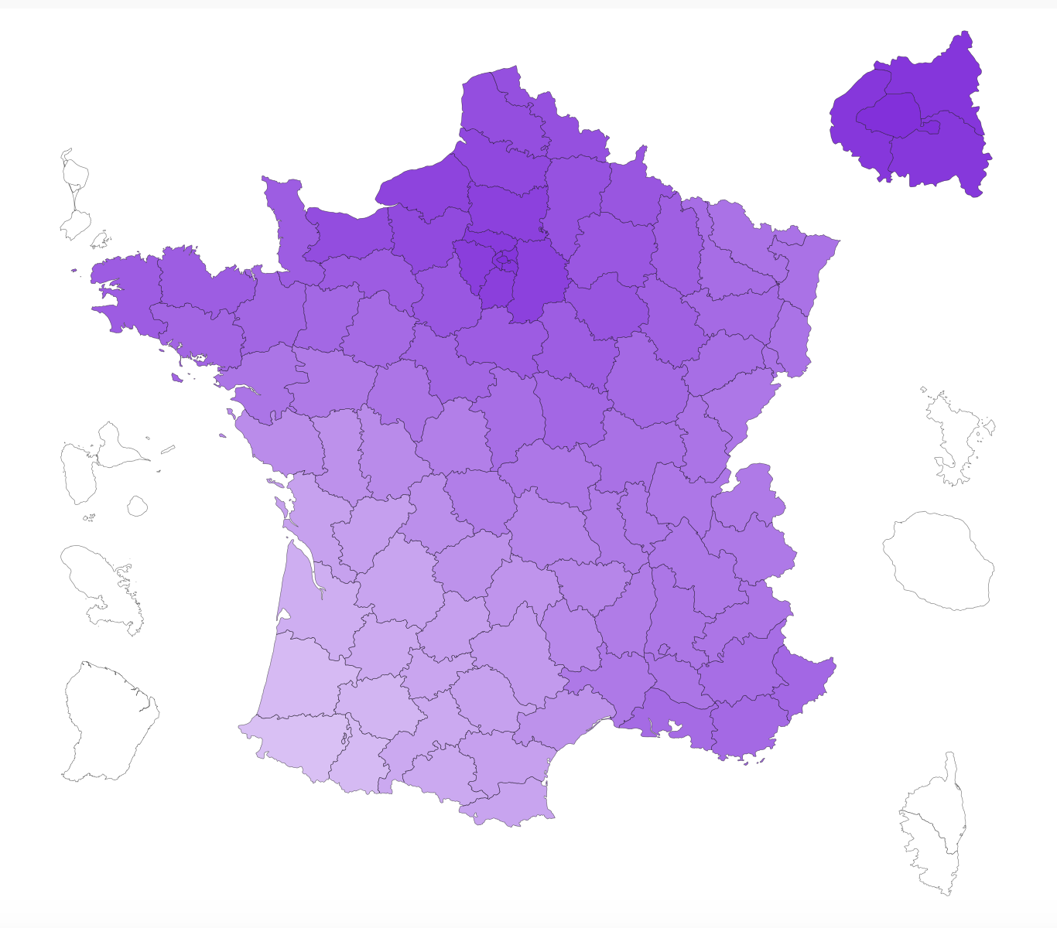
Impact on Bees in 2020

Slide 9


Eradication plan launched in 2014
To sum up :
Stabilisation accross the years but only an eradication of 75% or more leads to fewer hornets

Slide 10





Avalanche Propagation Model
First limitations
Easiest Propagation Model
Going further
Huge Averages
Huge Simplifications
Good approximation to avoid discrete study
Poisson Distribution for each unkonwn parameter
Need to take into account :
Pre-existing studies
Mean fly distance
Factor of Reproduction
Human interventions
Worst case scenario : Laisser faire Policy
Lack Of Data
Borders do not exist in Nature
Notes:
In this slide there is a background placeholder. Click to the small icon on the center of the slide and choose an image from computer. When add an image, you must sent it to back with Right Click on Image -> Send to Back -> Send to Back.

